Slide 1
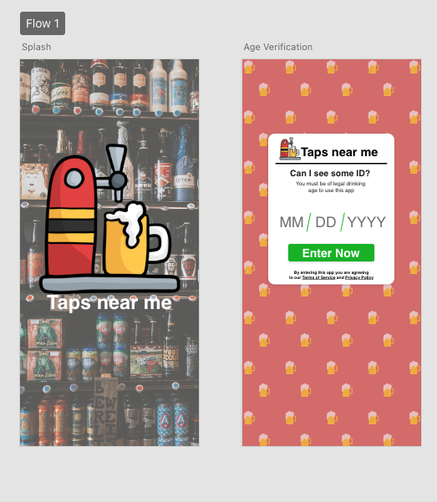
Taps Near Me
Alex Saltstein, Connor Smith, Tim Leonard, and Zach George

Slide 2
Project Topic
Currently, finding craft beer within a given radius is a manual process
Searching for brewery or bar in an area
Find menu
Determine if the menu has something that is desirable
Repeat as needed for more bars and breweries
This can result in either:
Finding desirable beer, but only after potentially multiple searches
Not finding desirable beer
Taps Near Me aims to resolve this issue by:
Gathering a user’s location
Prompting user to select criteria for searching for craft beer (style, ABV, etc.)
Prompting user to enter a search radius
Outputting locations of bars and breweries and their beer that match that criteria

Slide 3
Target Customers
Current Craft beer enthusiasts
Finding beers of a certain style, ABV, or other factors
Searching for seasonal items
Traveling and want to find what is near their destination
Soon-to-be craft beer enthusiasts
Starting close can be less daunting
Drinking “easy” styles can be more approachable
Drinking beers that have good reviews can make them want to try it

Slide 4
Potential Impacts
Less time spent searching for specific beers
Greater interest in craft beer scene
Increased traffic and sales at breweries and bars
Expanded brewery and bar menus
Increased competition between breweries and bars

Slide 5
Vision & Scope
Vision
Be a resource for finding specific craft beers in a given location
Document and rate craft beers that were tried by others
Create groups of craft beers for later reference
Oktoberfest
New Jersey IPAs
Low Alcohol Near Me
Send craft beer to other users
Expand application to wine, mead, and spirits
Scope
Map interface for displaying craft beers in given area
Search with criteria:
Beer Style
ABV
IBU (Bitterness)
Other qualities
Create groups of craft beers for later reference

Slide 6
Feature Priorities
Highest Priority
Searching for beers by accessing current location or entering zip code
Searching for beer by style
Searching for beer by ABV
Searching with multiple criteria
Output results on map interface
Output if no results are available
Medium Priority
Validating user’s age
Posting disclaimer about alcohol abuse and its risks
Searching for beer by IBU (bitterness)
Output results of craft beers with a interactive marker on map
Standardize information to be displayed on marker
Output if unable to find user location or access data
Lowest Priority
Search for beer by cost
Output costs for beer
Output if beers are currently on-tap, in cans, in bottles, or not available
Create craft beer groups

Slide 7
Questions?

